Slide 1
COMP 2920 : Software Architecture & Design

Slide 2
Software Architecture

Slide 3
What is software architecture
Software application architecture is:
the process of defining a structured solution that meets all of the technical and operational requirements,
It optimizes common quality attributes such as performance, security, and manageability.
It also involves a series of decisions based on a wide range of factors
Each decision can have considerable impact on the quality, performance, maintainability, and overall success of the application.

Slide 4
Dimensions of software complexity
Higher technical complexity
- Embedded, real-time, distributed, fault-tolerant
- Custom, unprecedented, architecture reengineering
- High performance
An average software project:
- 5-10 people
- 10-15 month duration
- 3-5 external interfaces
- Some unknowns & risks
Telecom
Switch
Defense Weapon System
Commercial
Compiler
National Air Traffic
Control System
Embedded
Automotive
Software
Lower
management
complexity
- Small scale
- Informal
- Single stakeholder
- “Products”
CASE Tool
Large-Scale
Organization/Entity
Simulation
Higher
management
complexity
- Large scale
- Contractual
- Many stake holders
- “Projects”
Small Scientific
Simulation
IS Application
Distributed Objects
(Order Entry)
Enterprise IS
(Family of IS
Applications)
Defense
MIS System
IS Application
GUI/RDB
(Order Entry)
Business
Spreadsheet
Lower technical complexity
- Mostly 4GL, or component-based
- Application reengineering
- Interactive performance

Slide 5
Forces in Software
Functionality
Cost
Compatibility
Capacity
Fail safe
Availability
Fault tolerance
Performance
Throughput
Technology churn
Resilience
The challenge over the next 20 years will not be speed or cost or performance;
it will be a question of complexity.
Bill Raduchel, Chief Strategy Officer, Sun Microsystems
Our enemy is complexity, and it’s our goal to kill it.
Jan Baan

Slide 6
The domain of architecting
Wojtek Kozaczynski
The “what”
The “why”
Architecture
Qualities
System
Features
Satisfies
Architecture
S/W
Requirements
Constrain
Architecture
Representation
System
Quality Attributes
Technology
The “who”
Produces
Defines
The “how”
Follows
Architect
Process
Skills
Defines role
Organization
Stakeholders

Slide 7
We all know that ...
Architecture and design are not the same thing
Architecture and infrastructure are the same thing
<my favorite technology> is the architecture
A good architecture is the work of a single architect
Architecture is flat, one blueprint is enough
Architecture is just structure
System architecture precedes software architecture
Architecture cannot be measured and validated
Architecture is a Science
Architecture is an Art

Slide 8
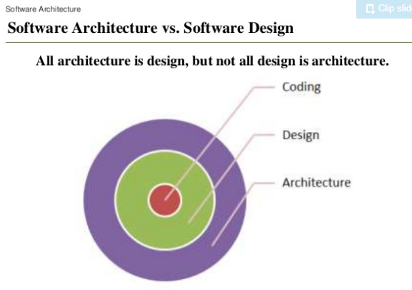
Architecture defined (again)
Architecture n (1555) 1: the art of science of building, specifically, the art or practice of designing and building structures and esp. habitable ones 2 a: formation or construction as or as if as the result of conscious act <the ~ of the garden> b: a unifying or coherent form or structure <the novel lacks ~>

Slide 9
Architecture
Software architecture encompasses the set of significant decisions about the organization of a software system
selection of the structural elements and their interfaces by which a system is composed
behavior as specified in collaborations among those elements
composition of these structural and behavioral elements into larger subsystem
architectural style that guides this organization

Slide 10
Architecture
Software architecture also involves
usage
functionality
performance
resilience
reuse
comprehensibility
economic and technology constraints and tradeoffs
aesthetic concerns

Slide 11
Architectural style
Mary Shaw, CMU
An architecture style defines a family of systems in terms of a pattern of structural organization.
An architectural style defines
a vocabulary of components and connector types
a set of constraints on how they can be combined
one or more semantic models that specify how a system’s overall properties can be determined from the properties of its parts

Slide 12
Benefits of Architecture style
An understanding of architectural styles provides several benefits.
It may provide a common language.
It will provide opportunities for conversations that are technology agnostic.
It facilitates a higher level of conversation that is inclusive of patterns and principles, without getting into specifics.
Architectural styles can be organized by their key focus area.

Slide 13
Many stakeholders, many views
Architecture is many things to many different interested parties
end-user
customer
project manager
system engineer
developer
architect
maintainer
other developers
Multidimensional reality
Multiple stakeholders
multiple views, multiple blueprints

Slide 14
Architectural view
An architectural view is a simplified description (an abstraction) of a system from a particular perspective or vantage point, covering particular concerns, and omitting entities that are not relevant to this perspective

Slide 15
Architecturally significant elements
Not all design is architecture
Main “business” classes
Important mechanisms
Processors and processes
Layers and subsystems
Architectural views = slices through models

Slide 16
Characteristics of a Good Architecture
Resilient
Simple
Approachable
Clear separation of concerns
Balanced distribution of responsibilities
Balances economic and technology constraints

Slide 17
Major areas of focus and the corresponding architectural styles
Category | Architecture styles
Communication | Service-Oriented Architecture (SOA), Message Bus
Deployment | Client/Server, N-Tier, 3-Tier
Domain | Domain Driven Design
Structure | Component-Based, Object-Oriented, Layered Architecture

Slide 18
Key Architectural Styles
Architecture style | Description
Client/Server | Segregates the system into two applications, where the client makes requests to the server. In many cases, the server is a database with application logic represented as stored procedures.
Component-Based Architecture | Decomposes application design into reusable functional or logical components that expose well-defined communication interfaces.
Domain Driven Design | An object-oriented architectural style focused on modeling a business domain and defining business objects based on entities within the business domain.
Layered Architecture | Partitions the concerns of the application into stacked groups (layers).
Message Bus | An architecture style that prescribes use of a software system that can receive and send messages using one or more communication channels, so that applications can interact without needing to know specific details about each other.
N-Tier / 3-Tier | Segregates functionality into separate segments in much the same way as the layered style, but with each segment being a tier located on a physically separate computer.
Object-Oriented | A design paradigm based on division of responsibilities for an application or system into individual reusable and self-sufficient objects, each containing the data and the behavior relevant to the object.
Service-Oriented Architecture (SOA) | Refers to applications that expose and consume functionality as a service using contracts and messages.

Slide 19
Methods for describing architecture
There are several well-known methods for describing architecture to others, including the following:
4+1 model
Agile modelling
IEEE 1471
UML model – for Object Oriented

Slide 20
Representing System Architecture (4+1 model)
Logical View
Implementation /Component View
End-user
Programmers
Software management
Functionality
Use Case View
Process View
Deployment View
System integrators
System engineering
Performance
Scalability
Throughput
System topology
Delivery, installation
Communication
Conceptual
Physical

Slide 21
Agile Modelling
This approach follows the concept that content is more important than representation.
This ensures that the models created are simple and easy to understand, sufficiently accurate, and consistent.
The simplicity of the document ensures that there is active stakeholder participation in the modeling of the artifact.

Slide 22
IEEE 1471
This recommended practice addresses the activities of the creation, analysis, and sustainment of architectures of software-intensive systems, and the recording of such architectures in terms of architectural descriptions .
A conceptual framework for architectural description is established.
The content of an architectural description is defined.

Slide 23
UML Model
This approach represents three views of a system model.
The functional requirements view (functional requirements of the system from the point of view of the user, including use cases);
The static structural view (objects, attributes, relationships, and operations including class diagrams); and
The dynamic behavior view (collaboration among objects and changes to the internal state of objects, including includes sequence, activity, and state diagrams).
Note : The models can integrate or overlap. UML diagrams can fit within 4+1 model

Slide 24
Object Oriented architecture
Object-oriented architecture is a design paradigm based on the division of responsibilities for an application or system into individual reusable and self-sufficient objects, each containing the data and the behavior relevant to the object.
An object-oriented design views a system as a series of cooperating objects, instead of a set of routines or procedural instructions.
Objects are discrete, independent, and loosely coupled; they communicate through interfaces, by calling methods or accessing properties in other objects, and by sending and receiving messages.

Slide 25
Overview of Prominent OO Methodologies
The Rumbaugh OMT
The Booch methodology
Jacobson's OOSE methodologies
Rational Unified Process.
UML - views & diagram to be modelled for system by UML.

Slide 26
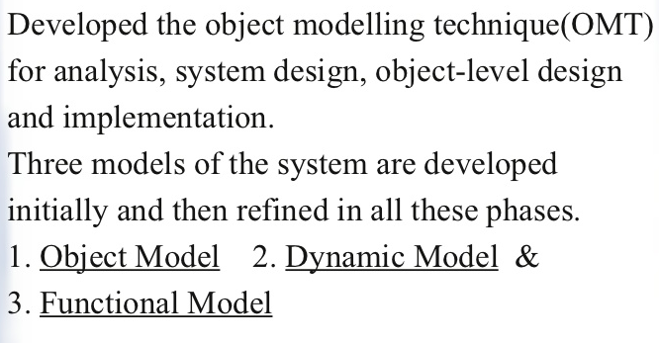
Rumbaugh Object Modeling Technique (OMT)
The object-modeling technique (OMT) is an object modeling language for software modeling and designing to develop object-oriented systems, and to support object-oriented programming.
OMT was developed as an approach to software development. The purposes of modeling according to Rumbaugh (1991) are:
Testing physical entities before building them (simulation),
Communication with customers,
Visualization (alternative presentation of information), and
Reduction of complexity.
OMT has proposed three main types of models:
Object model : The object model represents the static and most stable phenomena in the modeled domain. Main concepts are classes and associations, with attributes and operations. Aggregation and generalization (with multiple inheritance) are predefined relationships.
Dynamic model : The dynamic model represents a state/transition view on the model. Main concepts are states, transitions between states, and events to trigger transitions. Actions can be modeled as occurring within states. Generalization and aggregation (concurrency) are predefined relationships.
Functional model : The functional model handles the process perspective of the model, corresponding roughly to data flow diagrams. Main concepts are process, data store, data flow, and actors.

Slide 27
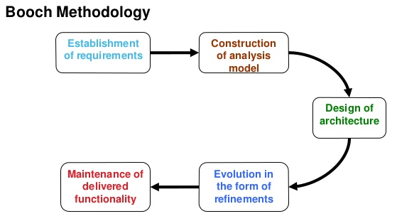
The Booch methodology
This methodology provides an object-oriented development in the analysis and design phases.
The analysis phase is split into steps.
The first step is to establish the requirements from the customer perspective. This analysis step generates a high-level description of the system's function and structure.
The second step is a domain analysis. The domain analysis is accomplished by defining object classes; their attributes, inheritance, and methods. State diagrams for the objects are then established.
The analysis phase is completed with a validation step. The analysis phase iterates between the customer's requirements step, the domain analysis step, and the validation step until consistency is reached.
The design phase is iterative.
A logic design is mapped to a physical design where details of execution threads, processes, performance, location, data types, data structures, visibility, and distribution are established.
A prototype is created and tested. The process iterates between the logical design, physical design, prototypes, and testing.
The Booch software engineering methodology is sequential in the sense that the analysis phase is completed and then the design phase is completed. The methodology is cyclical in the sense that each phase is composed of smaller cyclical steps. There is no explicit priority setting nor a non-monotonic control mechanism. The Booch methodology concentrates on the analysis and design phase and does not consider the implementation or the testing phase in much detail.

Slide 28
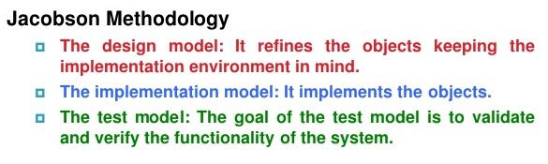
Jacobson's OOSE methodology
Object-oriented software engineering is an object-modeling language and methodology developed by Ivar Jacobson in 1992.
It is the first object-oriented design methodology to employ use cases to drive software design. It also uses other design products similar to those used by Object-modeling technique.
It is the primary sources of the Unified Modeling Language (UML) as the concepts and notation from OOSE have been incorporated into UML.
The methodology part of OOSE has since evolved into the Rational Unified Process (RUP).
OOSE has been largely replaced by the UML notation and by the RUP methodology.

Slide 29
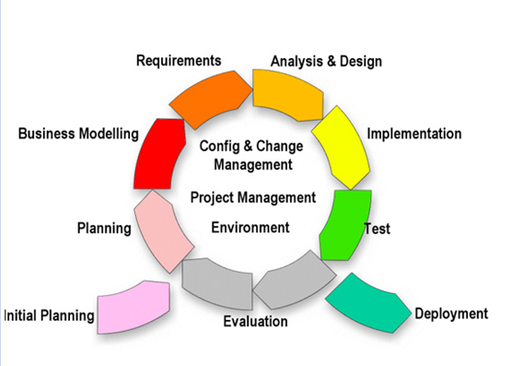
RUP (Rational Unified process/Phases)
RUP is a software development process from Rational, a division of IBM. It divides the development process into four distinct phases that each involve business modeling, analysis and design, implementation, testing, and deployment.
The four phases are:
Inception - The idea for the project is stated. The development team determines if the project is worth pursuing and what resources will be needed.
Elaboration - The project's architecture and required resources are further evaluated. Developers consider possible applications of the software and costs associated with the development.
Construction - The project is developed and completed. The software is designed, written, and tested.
Transition - The software is released to the public. Final adjustments or updates are made based on feedback from end users.

Slide 30
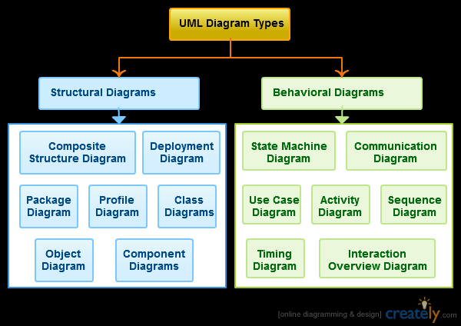
UML model
UML is a general purpose visual modeling language to visualize, specify, construct and document software system. Although UML is generally used to model software systems but it is not limited within this boundary. It is also used to model non software systems as well like process flow in a manufacturing unit etc.
UML is not a programming language but tools can be used to generate code in various languages using UML diagrams. UML has a direct relation with object oriented analysis and design. After some standardization UML is become an OMG (Object Management Group) standard.

Slide 31
The definition and history of creating the UML

Slide 32
History of the UML
1975-1988: object-oriented modeling languages, a new genre of object-oriented programming languages and increasingly complex applications
1989-1994: increasing of object-oriented methods (from fewer then 10 to more than 50), “method wars”. Booch, Jacobson's OOSE, Rumbaugh's OMT, Fusion, Shlaer-Mellor, and Coad-Yourdon methods.

Slide 33
History of the UML
1995-2003: Grady Booch (Rational Software Corporation), Ivar Jacobson (Objectory), and James Rumbaugh (General Electric) began to adopt ideas from each other's methods. UML 0.8 … 1
2004-…: UML 2.0.

Slide 34
Principles of object-oriented modeling of software systems
Aims of modeling:
Models help us to visualize a system as it is or as we want it to be.
Models permit us to specify the structure or behavior of a system.
Models give us a template that guides us in constructing a system.
Models document the decisions we have made.

Slide 35
Principles of object-oriented modeling of software systems
Basic principles of modeling:
The choice of what models to create has a profound influence on how a problem is attacked and how a solution is shaped.
Every model may be expressed at different levels of precision.
The best models are connected to reality.
No single model is sufficient. Every nontrivial system is best approached through a small set of nearly independent models.

Slide 36
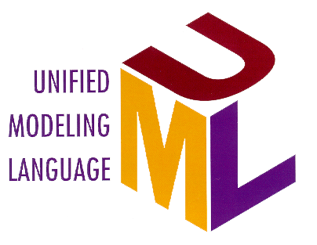
What is UML?
The Unified Modeling Language (UML) is a standard language for writing software blueprints. The UML may be used to visualize, specify, construct, and document the artifacts of a software intensive system.
The UML is only a language and so is just one part of a software development method.
Three major elements of model:
the UML's basic building blocks,
the rules that dictate how those building blocks may be put together,
some common mechanisms that apply throughout the UML.

Slide 37
The Value of the UML
Is an open standard
Supports the entire software development lifecycle
Supports diverse applications areas
Is based on experience and needs of the user community
Supported by many tools

Slide 38
Overview of the UML
Modeling elements
Relationships
Extensibility Mechanisms
Diagrams

